Slide 1

What Good Looks Like: Revenue Strategy
Revenue Optimization and Outside-In Thinking
Do Less.
Make it mean more.

Slide 2

Outside-In Thinking
Why Outside-In Thinking is the Key to Unlocking Revenue Growth
What if you discovered that the greatest barrier to your company's revenue growth is your own mindset? Many organizations remain trapped in an inside-out approach—obsessed with their products, features, and internal processes—instead of turning outward to truly grasp what matters to their customers. Imagine flipping this narrative. Outside-in thinking transforms the focus to customer needs and market dynamics, driving every strategy, sale, and campaign.
Is your business still fixated on praising your product rather than showing how it solves your customer’s problems? If so, you're leaving money—and loyalty—on the table.
Embracing outside-in thinking is no longer optional; it’s necessary for survival and success in today’s rapidly evolving markets.
Why Outside-In Thinking Matters
Are you genuinely focusing on the customer? Outside-in thinking demands it. Understanding your audience’s challenges, expectations, and aspirations is essential. Consider this: boosting customer retention by just 5% can increase profits by 25% to 95%, according to Bain & Company. Such an impact isn't accidental; it stems from a strategic shift to customer-centric approaches that prioritize the buyer’s experience. Are you ready to make that shift and harness the power of customer loyalty?
The Statistics Back It Up
Are you putting your customers at the heart of your business strategy? Companies that do enjoy higher satisfaction, stronger retention, and impressive revenue growth.
Consider this: During the pandemic, McKinsey found that 70% of consumers altered their shopping habits. Those businesses that swiftly adapted using customer data thrived, while others lagged.
What Good Looks Like: Revenue Strategy I 2025
2

Slide 3

Outside-In Thinking
If your approach isn't tailored to meet customers where they are, you're missing out on opportunity and growth. All too often we are don’t invite outside in thinking to test or challenge conventional thought. Or worse yet the status quo.
1. From Product-Focused to Customer-Led
What’s the common pitfall? Businesses often fall into the trap of highlighting themselves—their features, their accolades—instead of truly connecting with clients. Why is this detrimental? “First and foremost, invest in building an emotional relationship with your customers, not just a functional one,” emphasizes Robert Chatwani, Chief Marketing Officer at Atlassian. Why focus on emotion? Cultivating brand and product love leads to enhanced retention, robust growth, and sustainable revenue.
2. Identifying Customer Needs in Real-Time
Markets move at lightning speed, yet consumer behaviors evolve even quicker. How can businesses keep up with ever-shifting customer expectations? Active listening and data analysis are crucial. Have you considered harnessing emerging technologies like AI-powered analytics? These tools uncover insights and anticipate challenges before they arise, pushing the boundaries of innovation. By staying ahead, you unlock the potential for creativity and success.
Breaking Down Key Industry Challenges
(And How Outside-In Thinking Solves Them)
Let's tackle the roadblocks businesses encounter when integrating customer-led strategies. How does outside-in thinking pave the way forward? We can navigate these challenges through innovation and creativity. By questioning traditional methods and embracing dynamic solutions, we create momentum. Isn't it time for a transformative approach?
What Good Looks Like: Revenue Strategy I 2024
3

Slide 4
Outside-In Thinking
Meta Trends that are impacting organizations and their commercial teams
Critical thinking over tactical
Mindshare THEN Market share
Defined Messaging throughout the Customer Journey
Personalization to Customization
Strategic vs. Random
3. Innovate Fearlessly in a Competitive Landscape
Forward-thinking companies don't just respond—they disrupt. Why settle for the norm when you can innovate? Amazon's relentless focus on customer satisfaction propelled it to market leadership with groundbreaking conveniences like one-click ordering and Amazon Prime. By embedding customer feedback into its strategic core, 90% of product decisions are derived from it. According to the Harvard Business Review, Amazon has etched its name as an e-commerce icon.
4. Pivoting During Market Disruptions
Market shifts, like those witnessed during COVID-19, can either cripple a company or launch it into a new growth phase. How did some businesses thrive? By swiftly adapting to evolving customer needs. Consider Dropbox: its steadfast focus on user experience and seamless service positioned it as the quintessential solution in file sharing. Dropbox achieved organic growth by prioritizing customer feedback loops and became a household name through word-of-mouth referrals. The power of innovation and customer-centricity truly propels a business forward.
5. Overcoming Resistance to Change
Can even the most agile strategies succeed if a corporate culture remains stagnant? The answer lies in adopting outside-in thinking, which demands a mindset shift towards valuing flexibility and innovation. How does one foster a culture that embraces change? It starts at the top, with leaders who model and incentivize customer-first behaviors. By doing so, organizations can ignite a transformative journey that propels them ahead in today’s dynamic landscape.
What Good Looks Like: Revenue Strategy I 2025
4

Slide 5
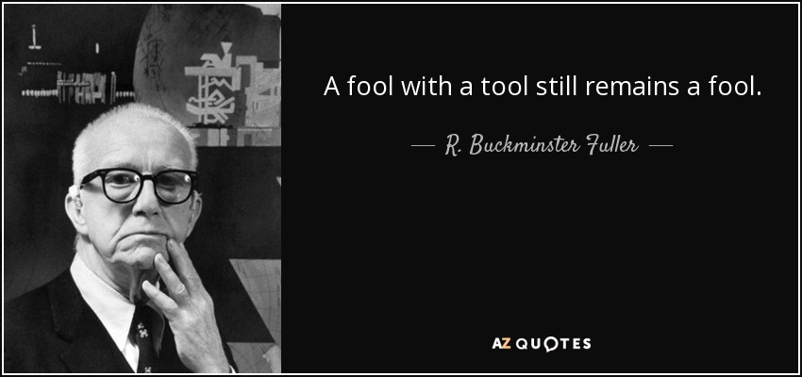
Outside-In Thinking
Technology is an Enabler, Not the Foundation
Adopting outside-in thinking is a transformative journey that takes time, but leveraging the right tools and technologies can fast-track your way to success. Have you considered how today’s advanced solutions—AI-driven CRM platforms, customer experience mapping software, and data visualization tools—empower businesses to gather and act on customer insights seamlessly?
Technology is a powerful enabler, yet it’s just one part of the equation. The real magic lies in strategy. Are you collecting data merely to possess it, or are you harnessing it to drive meaningful, long-term actions that enrich your customer experience and bottom line? Embrace innovation and creativity to propel your business forward.
What Can Outside-In Thinking Do for Your Business?
The transformative power of outside-in thinking transcends mere incremental improvements. Why settle for less when you can lead? Here's how to revolutionize your business:
Forge Unbreakable Customer Loyalty: Imagine creating a bond of trust that nurtures repeat business and turns customers into brand advocates. Anticipate their needs and watch loyalty blossom.
☞ Drive Revenue Growth: Embrace a customer-first mindset to unlock higher retention rates, expand your market share, and increase every customer's lifetime value.
What Good Looks Like: Revenue Strategy I 2025
5

Slide 6

Outside-In Thinking
☞ Stay ahead with an Innovative Edge: Outside-in thinking propels you beyond the competition. You maintain a perpetual state of readiness by evolving with—and even outpacing—market trends.
The wait and see group of today, become the laggards of tomorrow.
Today's most successful businesses don't merely react to the market—they shape it. Stepping into this role demands transforming your approach to revenue growth, starting from your customer's perspective.
Are you ready to lead the charge? We're here to guide you. Request a consultation to discover how to revolutionize your revenue optimization strategy with innovative, outside-in thinking. It's time to reimagine your approach, energize your team, and amplify your results.
When you center your decisions around your customers, you're not just following change but driving it.
What Good Looks Like: Revenue Strategy I 2025
6

Slide 7

We take all the noise, disruption, frustration and complexity of the new economy and bring you a clear, concise and simple path for your team to get results.
Bringing Simplicity to Complexity
What Great Looks Like
Contact us for help or support: kate@kateburda.com

